Slide 1
MRF Learning

Slide 2
Stock Volume (prices fluctuate)
Clique
Apple
Microsoft
Potentials:
φ(Amazon, Apple) - Kindle
φ(Amazon, Microsoft) - Azure
φ(Amazon, Hanes) - Clothing
φ(Microsoft, Apple) – obvious
φ(Hanes, Nike) – obvious
Hanes -> N(uh, vh)
Nike -> N(un, vn)
φ(Hanes, Nike) – Covariance Matrix
Amazon -> N(ua, va)
φ(Hanes, Amazon) – Covarance matrix
Amazon
Hanes Company
Nike

Slide 3
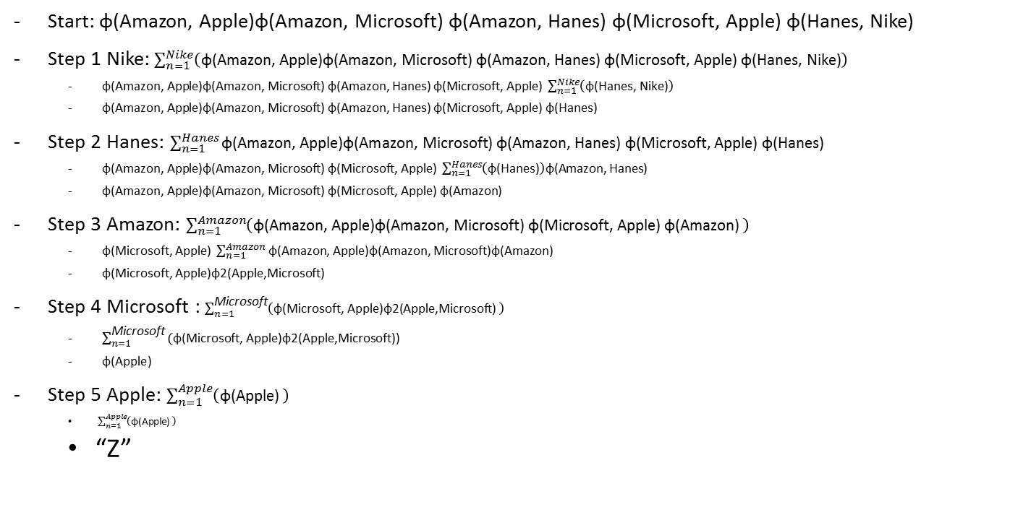
VE of the Graph
Hanes, Nike
- nothing
1 {Hanes, Nike} - phi(hanes)
2. {Hanes, Amazon} – phi(Amz)
3. {APL, MSFT, AMZ} – phi(APL, MSFT)
4. {APL, MSFT} – phi(APL)
5. {APL}
Start: φ(Amazon, Apple)φ(Amazon, Microsoft) φ(Amazon, Hanes) φ(Microsoft, Apple) φ(Hanes, Nike)
Step 1 Nike: $\sum_{n=1}^{Nike}{\left(\text{φ}\text{(}\text{Amazon}\text{, }\text{Apple}\text{)}\text{φ}\text{(}\text{Amazon}\text{, }\text{Microsoft}\text{) }\text{φ}\text{(}\text{Amazon}\text{, }\text{Hanes}\text{) }\text{φ}\text{(}\text{Microsoft}\text{, }\text{Apple}\text{) }\text{φ}\text{(}\text{Hanes}\text{, }\text{Nike}\text{)}\right)}$
$\text{φ}\text{(}\text{Amazon}\text{, }\text{Apple}\text{)}\text{φ}\text{(}\text{Amazon}\text{, }\text{Microsoft}\text{) }\text{φ}\text{(}\text{Amazon}\text{, }\text{Hanes}\text{) }\text{φ}\text{(}\text{Microsoft}\text{, }\text{Apple}\text{)} \sum_{n=1}^{Nike}{\left(\text{φ}\text{(}\text{Hanes}\text{, }\text{Nike}\text{)}\right)}$
$\text{φ}\text{(}\text{Amazon}\text{, }\text{Apple}\text{)}\text{φ}\text{(}\text{Amazon}\text{, }\text{Microsoft}\text{) }\text{φ}\text{(}\text{Amazon}\text{, }\text{Hanes}\text{) }\text{φ}\text{(}\text{Microsoft}\text{, }\text{Apple}\text{)}$ $\text{φ}$(Hanes)
Step 2 Hanes: $\sum_{n=1}^{Hanes}{\text{φ}\text{(}\text{Amazon}\text{, }\text{Apple}\text{)}\text{φ}\text{(}\text{Amazon}\text{, }\text{Microsoft}\text{) }\text{φ}\text{(}\text{Amazon}\text{, }\text{Hanes}\text{) }\text{φ}\text{(}\text{Microsoft}\text{, }\text{Apple}\text{) }\text{φ}\text{(}\text{Hanes}\text{) }}$
$\text{φ}\text{(}\text{Amazon}\text{, }\text{Apple}\text{)}\text{φ}\text{(}\text{Amazon}\text{, }\text{Microsoft}\text{) }\text{φ}\text{(}\text{Microsoft}\text{, }\text{Apple}\text{)} \sum_{n=1}^{Hanes}{\left(\text{φ}\text{(}\text{Hanes}\text{)}\right)\text{φ}\text{(}\text{Amazon}\text{, }\text{Hanes}\text{)}}$
$\text{φ}\text{(}\text{Amazon}\text{, }\text{Apple}\text{)}\text{φ}\text{(}\text{Amazon}\text{, }\text{Microsoft}\text{) }\text{φ}\text{(}\text{Microsoft}\text{, }\text{Apple}\text{)}$ $\text{φ}\text{(}\text{Amazon}$)
Step 3 Amazon: $\sum_{n=1}^{Amazon}{\left(\text{φ}\text{(}\text{Amazon}\text{, }\text{Apple}\text{)}\text{φ}\text{(}\text{Amazon}\text{, }\text{Microsoft}\text{) }\text{φ}\text{(}\text{Microsoft}\text{, }\text{Apple}\text{) }\text{φ}\text{(}\text{Amazon}\text{) }\right)}$
$\text{φ}\text{(}\text{Microsoft}\text{, }\text{Apple}\text{)} \sum_{n=1}^{Amazon}{\text{φ}\text{(}\text{Amazon}\text{, }\text{Apple}\text{)}\text{φ}\text{(}\text{Amazon}\text{, }\text{Microsoft}\text{)}\text{φ}\text{(}\text{Amazon}\text{)}}$
$\text{φ}\text{(}\text{Microsoft}\text{, }\text{Apple}\text{)}\text{φ}\text{2}\text{(}\text{Apple}\text{,}\text{Microsoft}\text{)}$
Step 4 $\text{Microsoft}$: $\sum_{n=1}^{\text{Microsoft}}{\left(\text{φ}\text{(}\text{Microsoft}\text{, }\text{Apple}\text{)}\text{φ}\text{2(}\text{Apple}\text{,}\text{Microsoft}\text{) }\right)}$
$\sum_{n=1}^{\text{Microsoft}}{\text{(}\text{φ}\text{(}\text{Microsoft}\text{, }\text{Apple}\text{)}\text{φ}\text{2(}\text{Apple}\text{,}\text{Microsoft}\text{))}}$
$\text{φ}\text{(}\text{Apple}$)
Step 5 Apple: $\sum_{n=1}^{Apple}{\left(\text{φ}\text{(}\text{Apple}\text{) }\right)}$
$\sum_{n=1}^{Apple}{\left(\text{φ}\text{(}\text{Apple}\text{) }\right)}$
“Z”
Hanes, Amazon
Apple, Microsoft, Amazon
Apple, Microsoft
Apple

Slide 4
Stock Volume (prices fluctuate)
Clique
Clique
Apple
Apple
Microsoft
Apple
Microsoft
Amazon
Potentials:
φ(Amazon, Apple) - Kindle
φ(Amazon, Microsoft) - Azure
φ(Amazon, Hanes) - Clothing
φ(Microsoft, Apple) – obvious
φ(Hanes, Nike) – obvious
Hanes -> N(uh, vh)
Nike -> N(un, vn)
φ(Hanes, Nike) – Covariance Matrix
Amazon -> N(ua, va)
φ(Hanes, Amazon) – Covarance matrix
Microsoft
Amazon
Apple
Clique
Clique
Clique
Amazon
Nike
Microsoft
Hanes Company
Clique
Apple
Apple
Apple
Hanes Company
Hanes Company

Slide 5
Amazon : high = p(amazon = h , micro = h, apple=h)= p(a=h, m=h)*p(a=h, a=h)*p(m=h, a=h)
Apple
Microsoft
Amazon : high = p(amazon = m , micro = h, apple=h)= p(a=h, m=h)*p(a=h, a=h)*p(m=h, a=h)
Apple
high
med
low
Amazon
2
3
high
1
Micro
med
0
150
50
Hanes Company
Nike
low
78
34
1000
Amazon = medium, Microsoft = hight, Apple = low = 462

Slide 6
Goal
Step 1. Generate samples with known parameters
Assume all potentials are Multivariate Gaussian /Categorical
Perform message passing (establish Clique Tree) so we can do marginal inference
With marginal distributions, we can topologically sample
Alternatively -> if we do Gaussian’s we can just sample this way – I think.
Step 2. Hard part -> Learn from these samples and see if you get the same values back for the MRF. -> that means we trained correctly
Requires gradient ascent and inference in MRF at each step. <- exact parameter estimation
Pseudolikelihood approach as well <- Simple Gibbs Sampling to get this value I think (need to read more into this)

